Slide 1
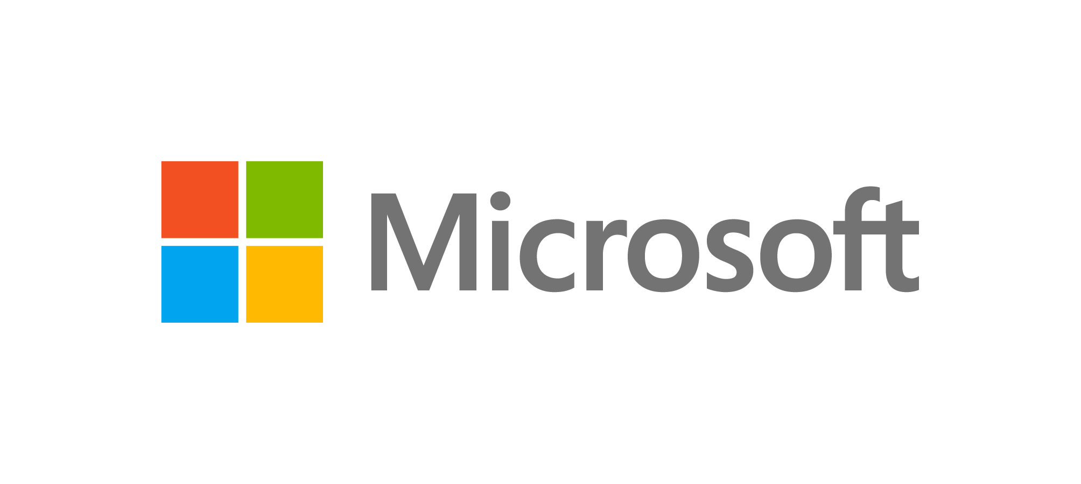
SQL Server 2022 editions
Azure-enabled with continued performance and security innovation
Enterprise
Mission-critical performance and intelligence for tier 1 databases
Standard
Full featured database with for mid-tier applications and data marts
Feature highlights
Unlimited cores of CPU
Unlimited memory
Azure Synapse Link for SQL (multi-threaded snapshot)
Link feature for Azure SQL Managed Instance
Built-in query intelligence: DOP feedback, CE Feedback, Memory Grant Feedback
Contained Availability Group
AVX 512 extension for batch mode
Express
Free, entry-level database for small web and mobile apps
Feature highlights
Up to 24 cores of CPU
Up to 128 GBs of memory
Azure Synapse Link for SQL
Link feature for Azure SQL Managed Instance (basic availability groups)
Buffer Pool Parallel Scan
Backups to S3-compatible object storage
Feature highlights
Up to 4 cores of CPU
Up to 1410 MBs of memory
Microsoft Purview Policies
Azure AD authentication
Built-in query intelligence: PSP Optimization, Optimized plan forcing
Query store on by default for new databases
Data Lake Virtualization
Ledger
Timeseries support
+ Standard features
+ Express features
+ Express features
Developer
Free to use with all the features of Enterprise Edition specifically for dev/test in non-production environments
Build once and deploy across any SQL Server edition without changing your app

Slide 2
What’s new in SQL Server 2022
SQL Server 2022 new features |  | Express | Standard | Enterprise
Compute and storage | Maximum number of cores | 4 | 24 | OS Max
 | Maximum memory utilized per instance | 1410 MB | 128 GB | OS Max
 | Maximum relational database size | 10 GB | 524 PB | 524 PB
Azure-enabled | Azure Synapse Link for SQL |  | ✕ | ✕
 | Ledger | ✕ | ✕ | ✕
 | Link feature for Azure SQL Managed Instance |  |  | ✕
 | Link feature for Azure SQL Managed Instance (basic availability groups) |  | ✕
 | Microsoft Purview policies | ✕ | ✕ | ✕
Choice of language and platform | JSON T-SQL Enhancements | ✕ | ✕ | ✕
 | Modern T-SQL surface area | ✕ | ✕ | ✕
Industry-leading performance and availability | Query Store by default for new databases | ✕ | ✕ | ✕
 | Query Store: Read-replica support |  |  | ✕
 | Built-in query intelligence: Parameter Sensitive Plan (PSP) Optimization, Optimized plan forcing | ✕ | ✕ | ✕
 | Built-in query intelligence: CE Feedback, DOP Feedback, Memory Grant Feedback |  |  | ✕
 | Contained Availability Group |  |  | ✕
 | Buffer Pool Parallel Scan |  | ✕ (limited to 2 threads, over 64GB Mem only) | ✕
 | AVX 512 extension for batch mode |  |  | ✕
 | Intel QAT Enhancements for Backup |  | ✕ (SW only) | ✕ (HW + SW)
 | Timeseries support | ✕ | ✕ | ✕
Secure and reliable | Always Encrypted with secure enclaves - new features | ✕ | ✕ | ✕
 | Granular permissions for Dynamic Data Masking | ✕ | ✕ | ✕
Analytics | Data Lake Virtualization | ✕ | ✕ | ✕
 | Object Storage Integration with S3-compatible storage |  | ✕ | ✕

Slide 3
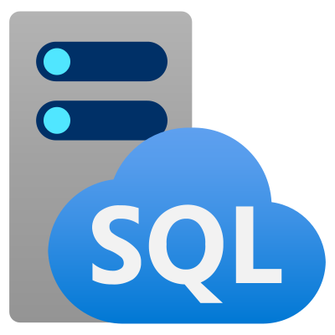


SQL Server 2022 continues to deliver unparalleled value
Business continuity through Azure
Seamless analytics over on-prem operational data
Visibility over your entire data estate
Most secure over the last 10 years⁶
Industry-leading performance and availability
2022 additions
Azure extension for SQL Server
Link feature for Azure SQL Managed Instance
Azure Synapse link for SQL
Azure Purview policies
SQL Server Ledger
Large memory and concurrency scalability
Data virtualization for any data lake
Object storage backup and restore
Query Store on by default with replica support
Query Store hints
Intelligent Query Processing NextGen
JSON functions
Modern T-SQL surface area
Time series support
Integrated acceleration & offloading
2019 additions
2017 additions
Azure Machine Learning and Spark ML
Support for Kubernetes deployment
Free supported Java
Native UTF-8 support
In-Memory Database: Persistent Memory support
Accelerated database recovery
Free DR to Azure Always Encrypted with secure enclaves
Data classification & auditing
Vulnerability assessment
Support for Linux including Red Hat Enterprise Linux (RHEL), SUSE Linux Enterprise Server (SLES), and Ubuntu
Support for Docker containers on Linux and Windows
Python language support
Support for graph data
Automatic plan correction and adaptive query processing
Cross platform availability groups
Full list of SQL Server 2022 editions and supported features available on SQL Docs
© 2018 Microsoft Corporation. All rights reserved. This material is provided for informational purposes only. Microsoft makes no warranties, express or implied.

